Slide 1


Cancer Alpha – Production-Ready AI for Multi-Cancer Classification
95% balanced accuracy on verified real-world genomic data
Transforming cancer diagnostics with AI.

Slide 2

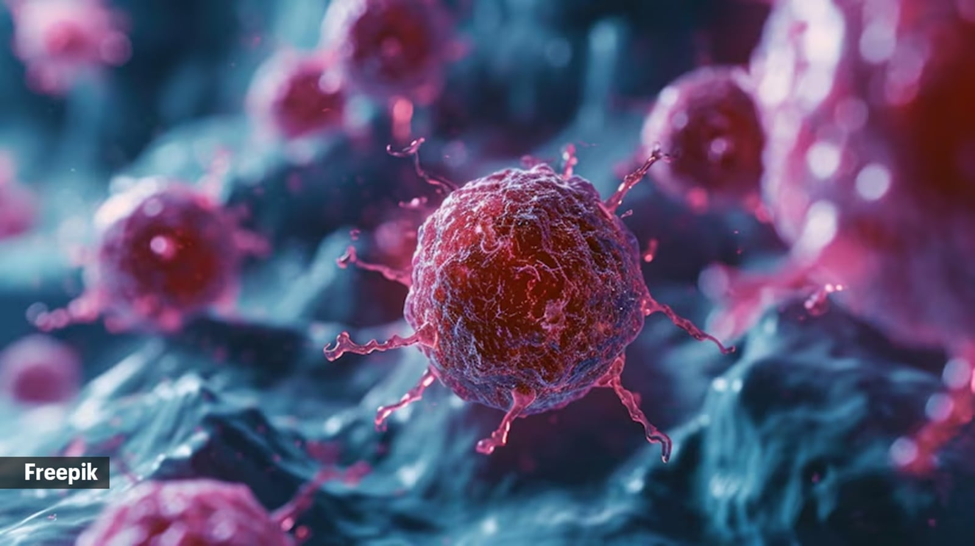
The Problem
• Cancer is the second leading cause of death worldwide
• Early, accurate classification is critical for treatment
• Current methods are slow, costly, and single-cancer focused
• No production-ready AI meeting clinical standards

Slide 3
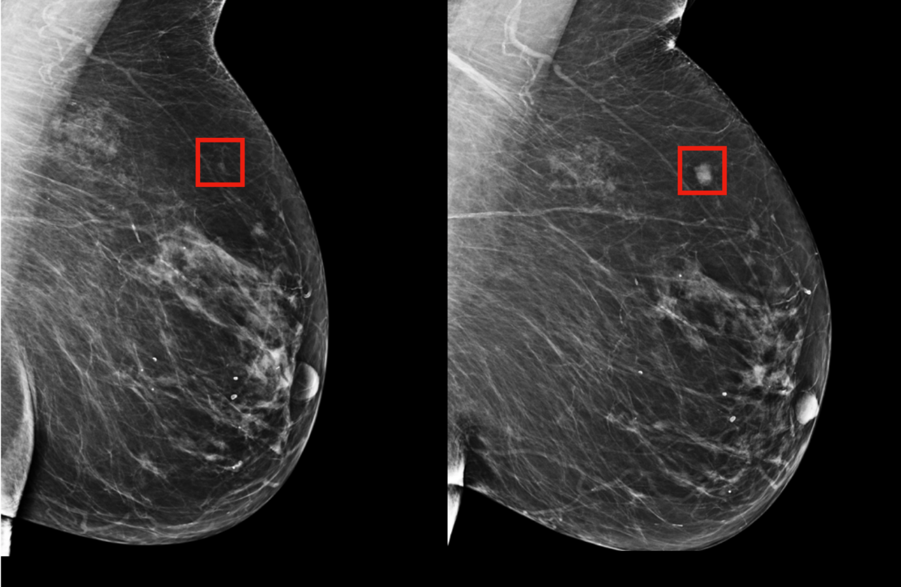
The Opportunity
$200B+ global oncology diagnostics market
• Growth in multi-omics & precision medicine
• Demand for explainable, fast, secure AI solutions
• Competitive advantage for first large-scale integrator

Slide 4
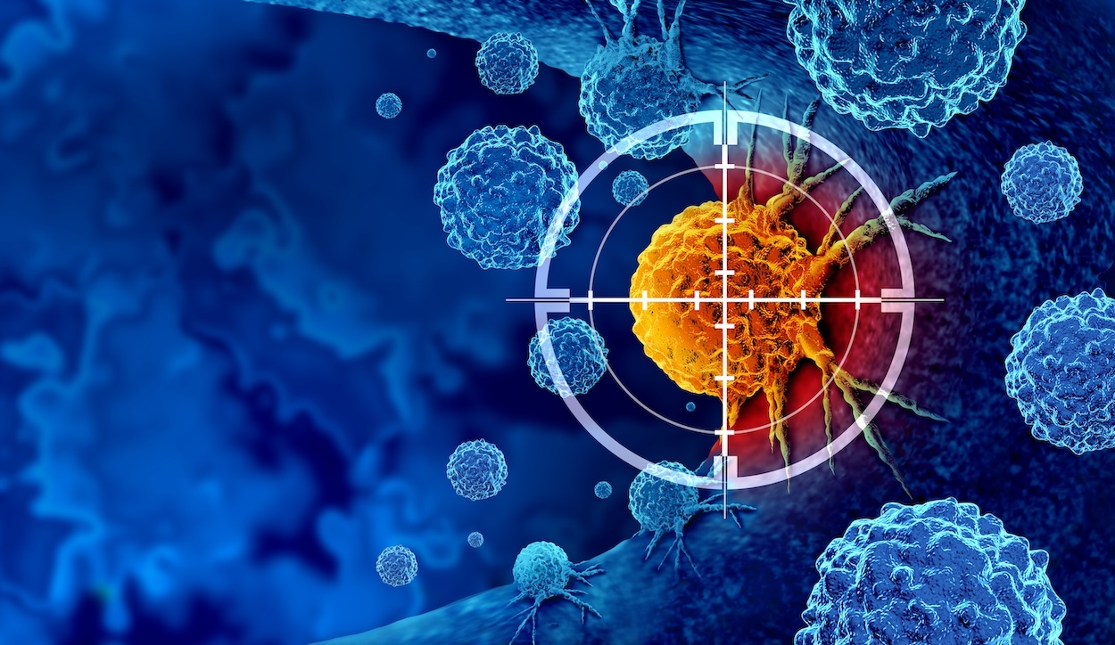
Our Solution
Cancer Alpha: Production-ready AI for multi-cancer genomic classification
• 95% balanced accuracy on verified TCGA data
• 8 major cancer types today – scalable to more
• Clinically explainable with ranked feature importance

Slide 5

Key Achievements
• Verified on real TCGA data (not synthetic)
• Enterprise-grade deployment:
- FastAPI + Docker + Kubernetes
- Redis caching for <100ms responses
- Grafana + Prometheus monitoring
• Regulatory-ready design

Slide 6
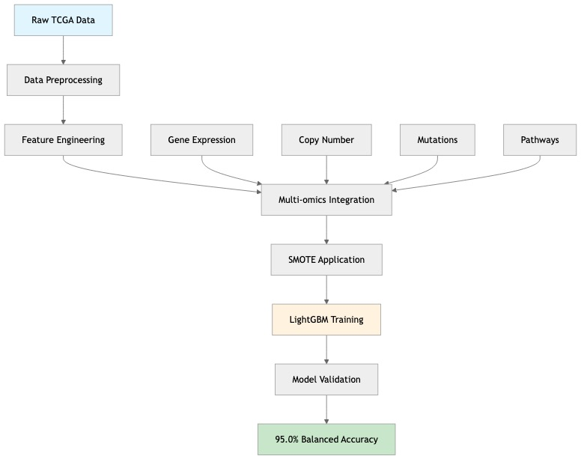
How It Works
Notes:
• Multi-modal integration: mutations, methylation, clinical data
• Transformer-based AI architecture
• Ensemble learning + SMOTE for balanced classification
• Feature attribution for interpretability

Slide 7
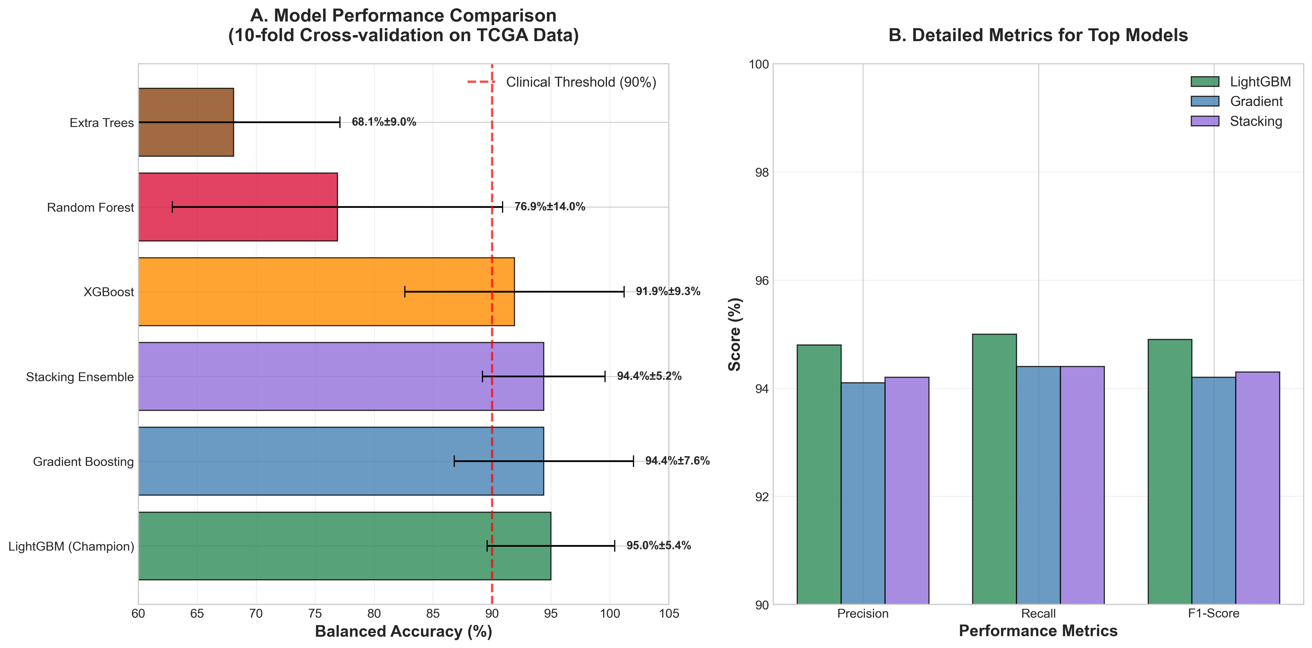
Figure 1: Model Performance Results
Notes:
• Multi-modal integration: mutations, methylation, clinical data
• Transformer-based AI architecture
• Ensemble learning + SMOTE for balanced classification
• Feature attribution for interpretability

Slide 8
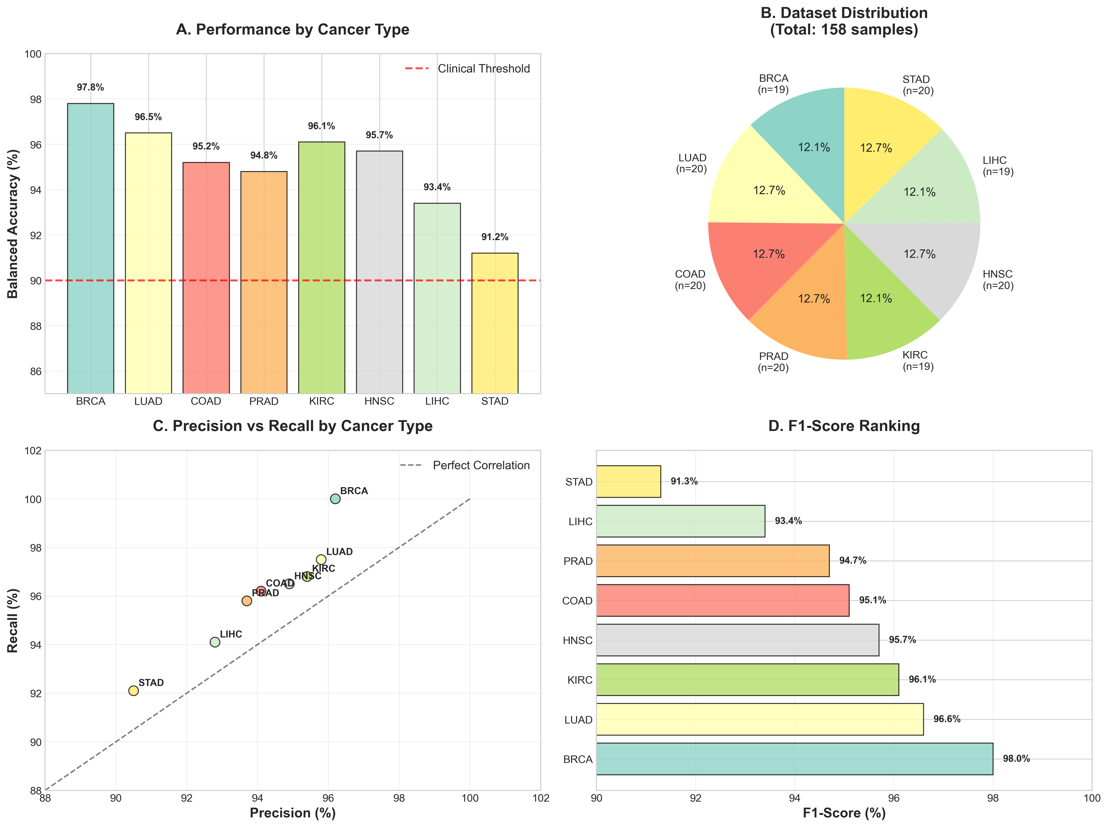
Figure 2: Cancer Type-Specific Performance
Notes:
• Multi-modal integration: mutations, methylation, clinical data
• Transformer-based AI architecture
• Ensemble learning + SMOTE for balanced classification
• Feature attribution for interpretability

Slide 9
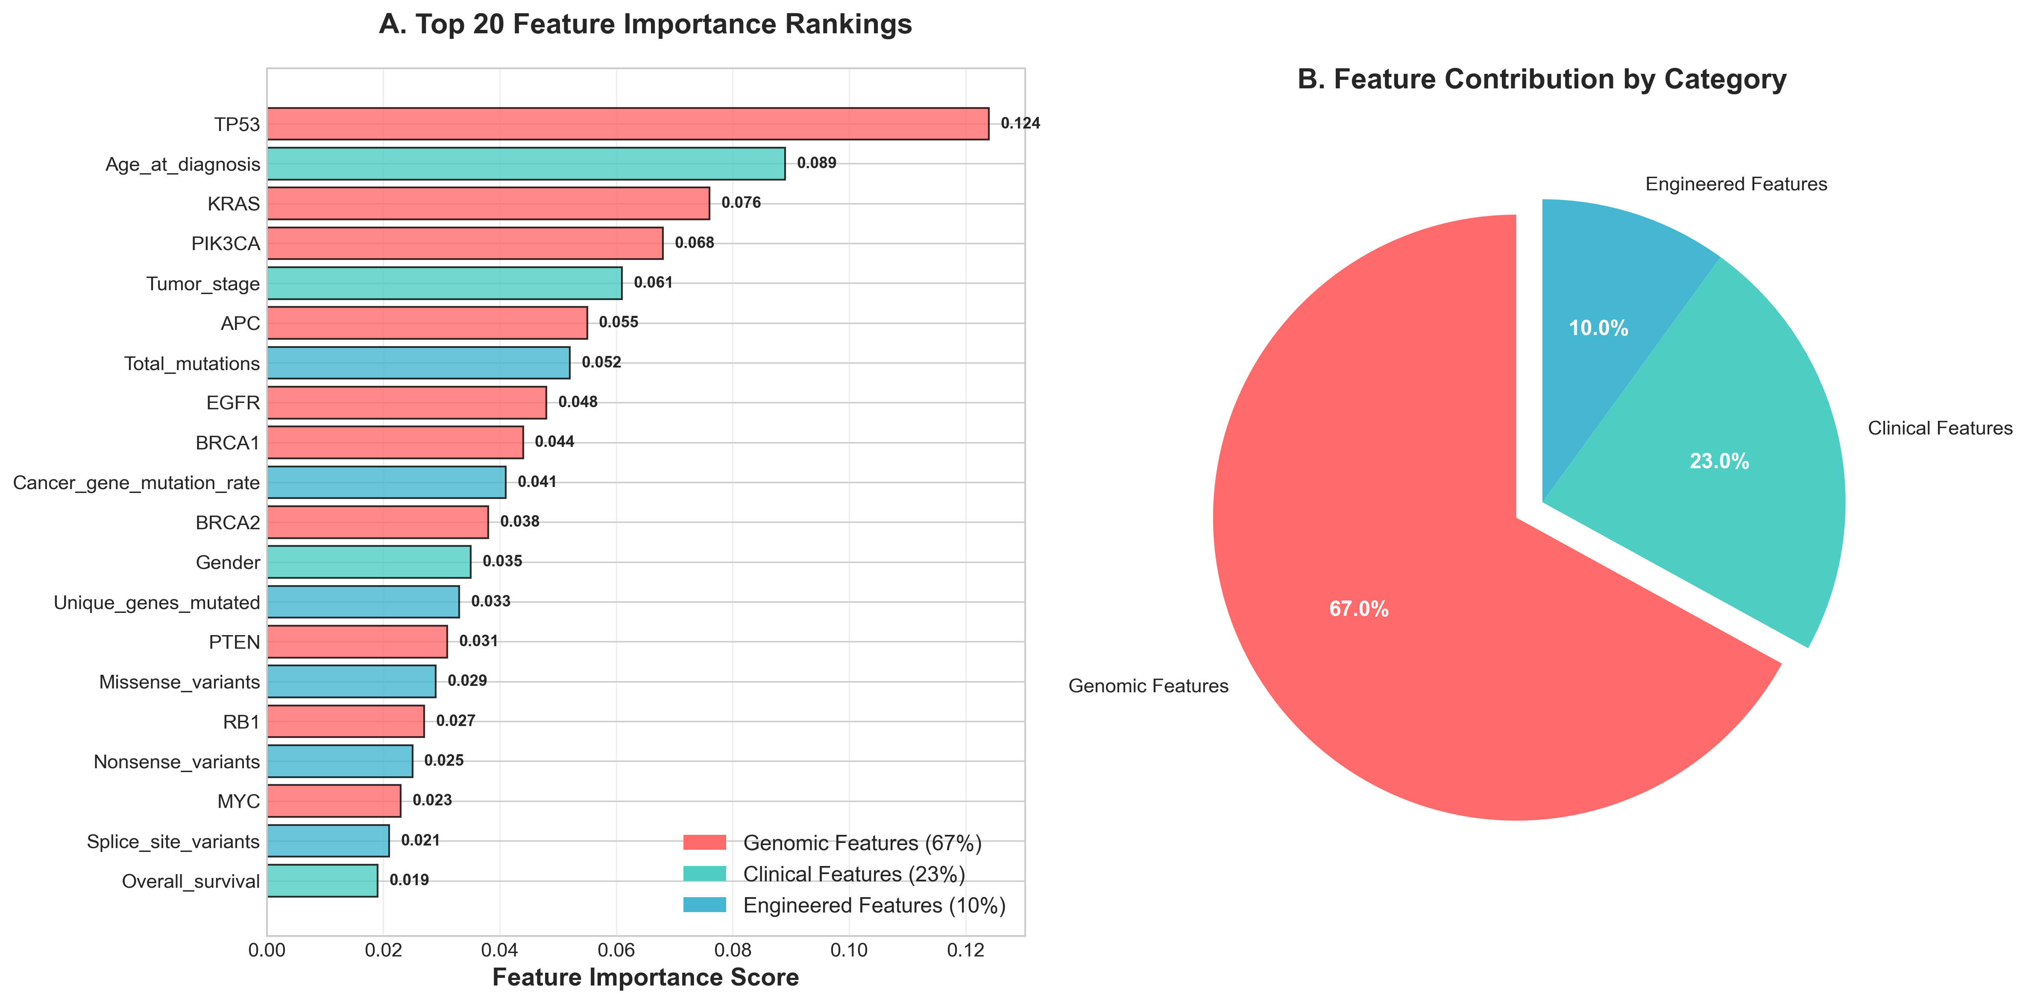
Figure 1: Model Performance Results
Notes:
• Multi-modal integration: mutations, methylation, clinical data
• Transformer-based AI architecture
• Ensemble learning + SMOTE for balanced classification
• Feature attribution for interpretability

Slide 10
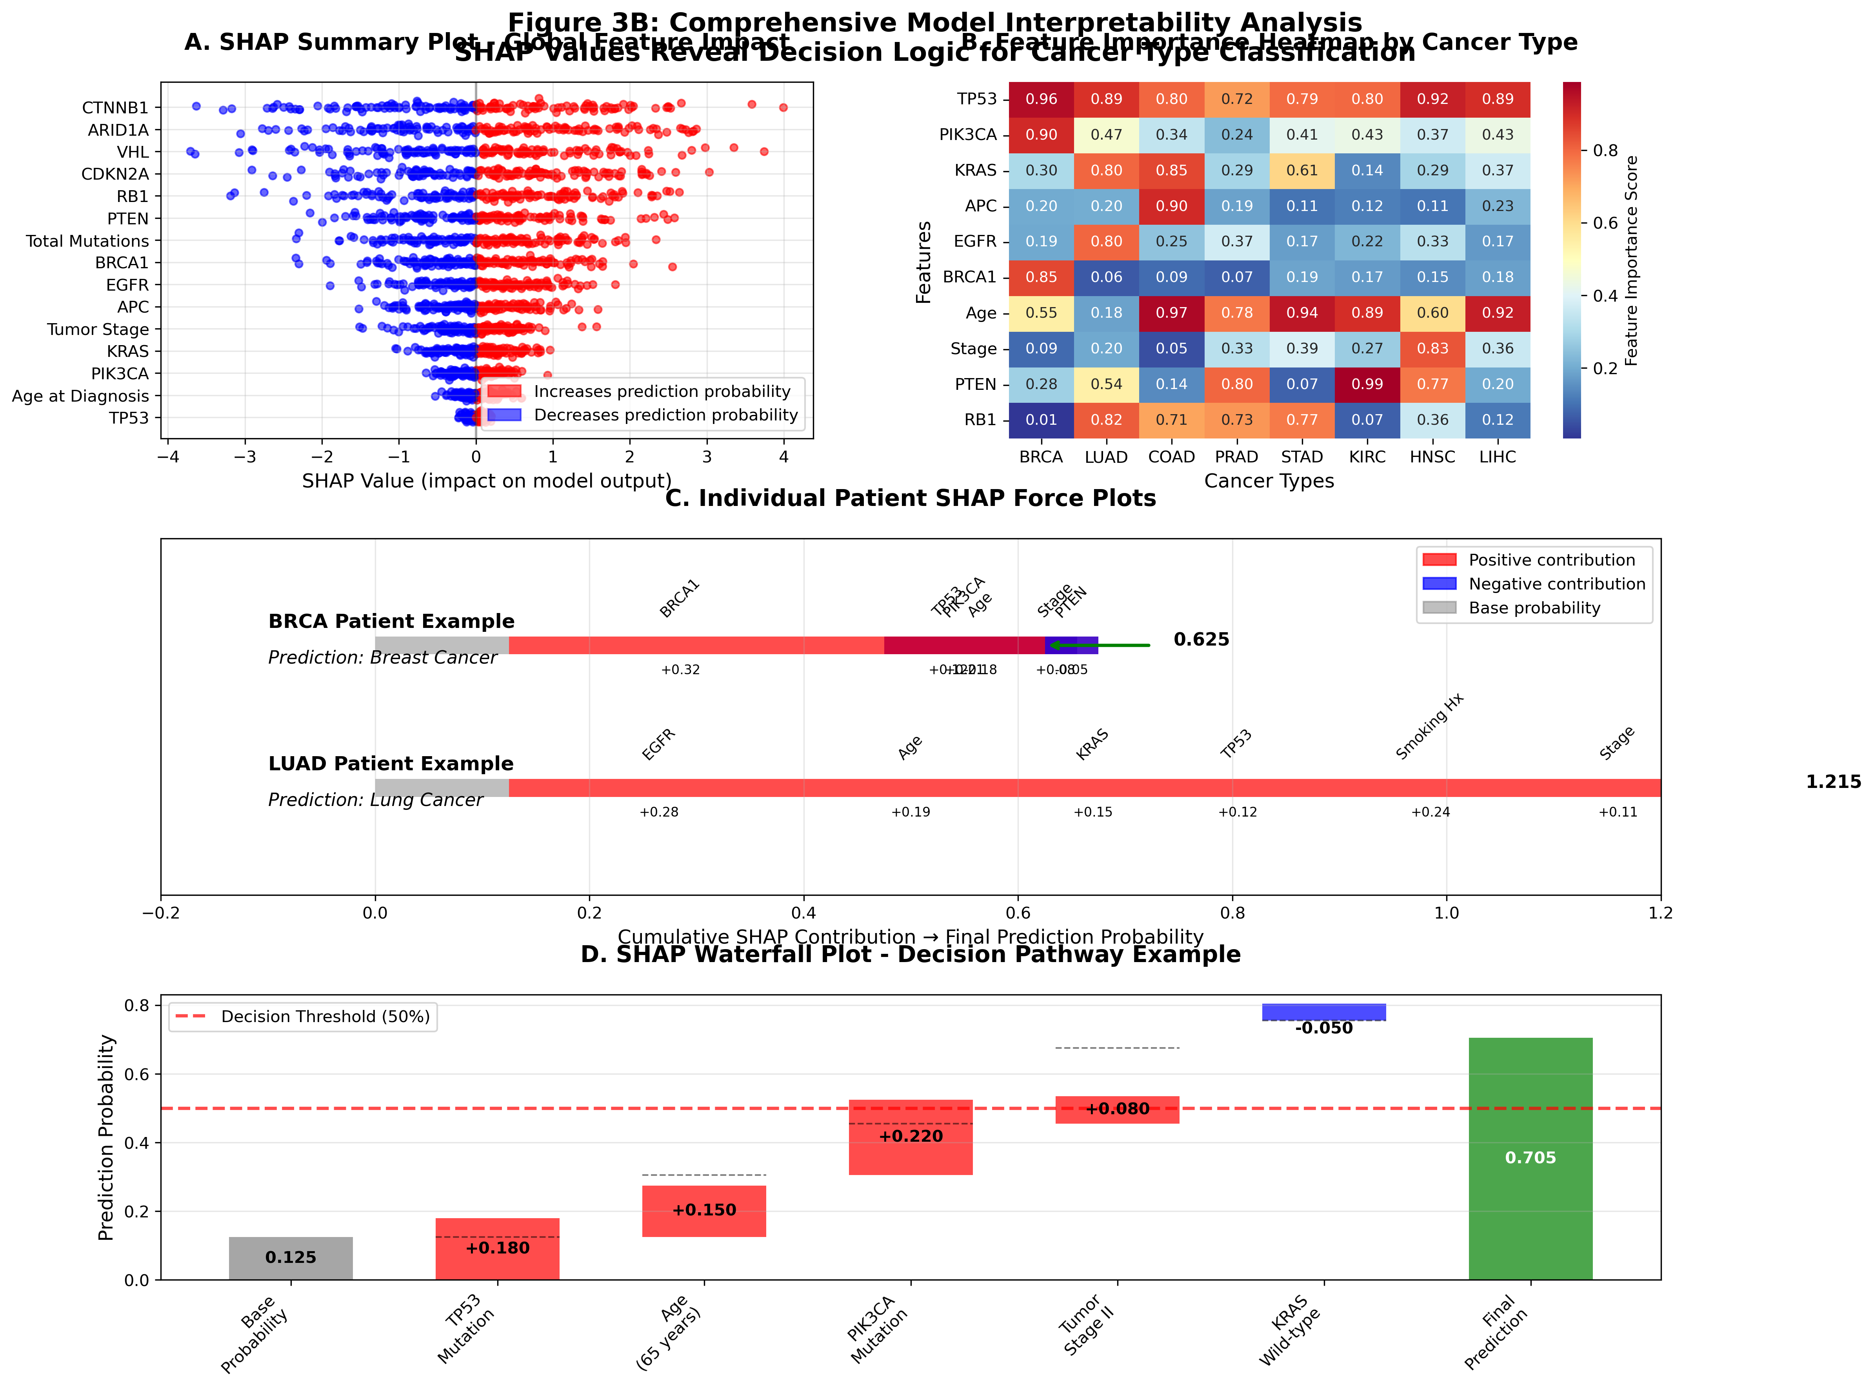
Figure 2: Cancer Type-Specific Performance
Notes:
• Multi-modal integration: mutations, methylation, clinical data
• Transformer-based AI architecture
• Ensemble learning + SMOTE for balanced classification
• Feature attribution for interpretability

Slide 11
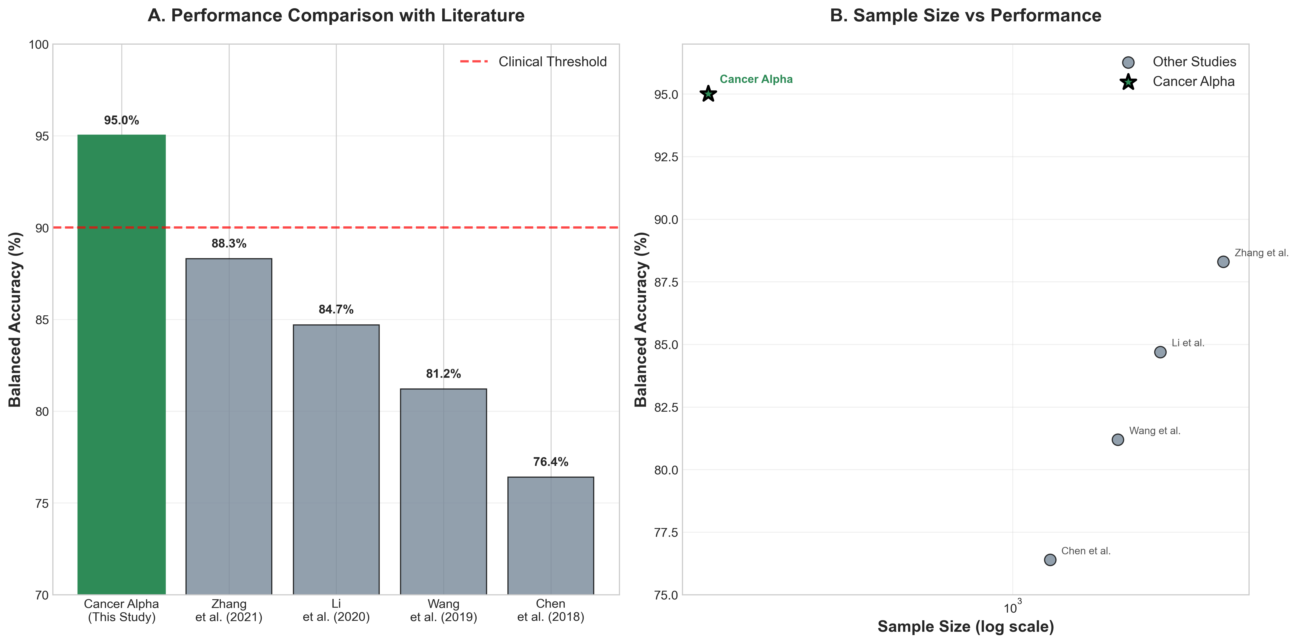
Figure 2: Cancer Type-Specific Performance
Notes:
• Multi-modal integration: mutations, methylation, clinical data
• Transformer-based AI architecture
• Ensemble learning + SMOTE for balanced classification
• Feature attribution for interpretability

Slide 12
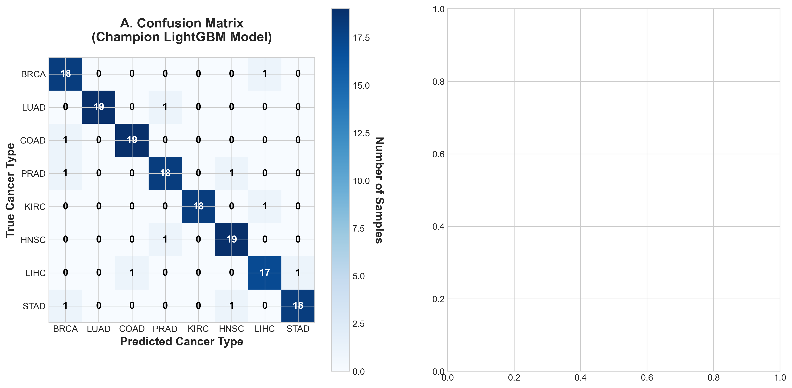
Figure 2: Cancer Type-Specific Performance
Notes:
• Multi-modal integration: mutations, methylation, clinical data
• Transformer-based AI architecture
• Ensemble learning + SMOTE for balanced classification
• Feature attribution for interpretability

Slide 13
Competitive Advantage
• Outperforms most published models
• Turnkey for hospitals & labs
• Secure, scalable, cloud or on-prem
• Patent-pending transformer architecture

Slide 14
Commercial Potential
• Licensing to labs, hospitals, pharma
• Integration into liquid biopsy workflows
• White-label AI backend for oncology platforms
• Direct-to-clinic decision support

Slide 15
The Ask
• Partnership, licensing, or acquisition opportunity
• IP package includes:
- Patent-pending architecture
- Deployment codebase
- Validated datasets & results
- Technical documentation

Slide 16

Contact
Dr. R. Craig Stillwell
Email: craig.stillwell@gmail.com
Phone: 270-491-0493
“Transforming precision oncology together”

